Slide 1

Leveling Up Comic Creation: AI & Interactive Storytelling
Anyone can imagine, but only the fearless can make them come true. Let your imagination run wild with AI
~ Sri Sai Saketh C

Slide 2
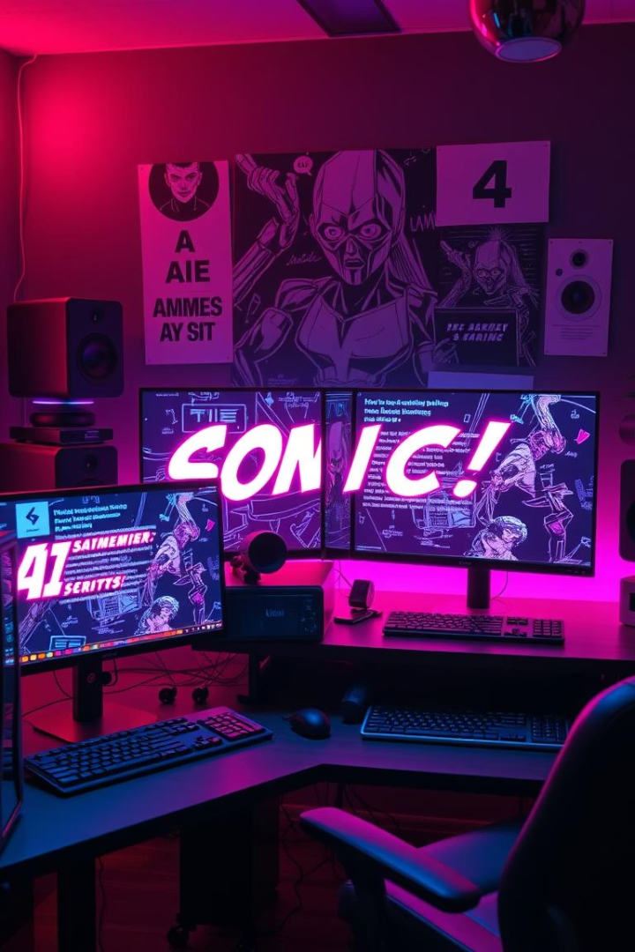
The AI Toolkit Used
AI Art Generators
Script Writers
DALL-E 3 and Stable Diffusion to create vivid character and scene art.
GPT-4o to assist with plots and natural dialogue creation.
Rapid Prototyping and Music
Used Canva for comic book strip and Suno for Background music

Slide 3
AI-Powered Character Design
Generate 50+ design and art variations
Workflow integrates AI concepts into Canva and photoroom.
Refine details with iterative text prompts
Reduce initial artist costs dramatically
Empowers creators with creative flexibility and speed.

Slide 4
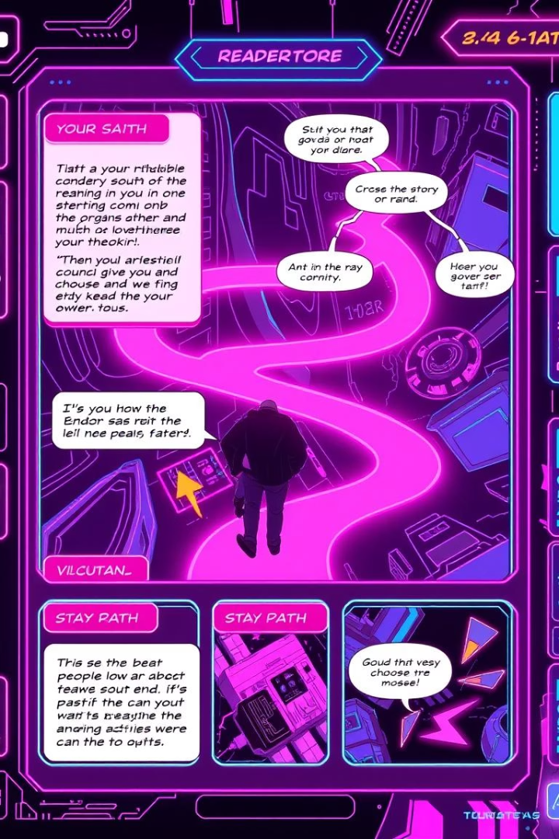



Interactive Storytelling: Branching Tales
Choose Your Adventure
Your decisions create diverse narrative outcomes.
Impact
Interactive comics(music/video) get 3x higher reader engagement.
Expolore
With AI-powered character design tools, creators can generate a variety of designs and refine them through text prompts. This reduces the initial artist costs significantly.

Slide 5
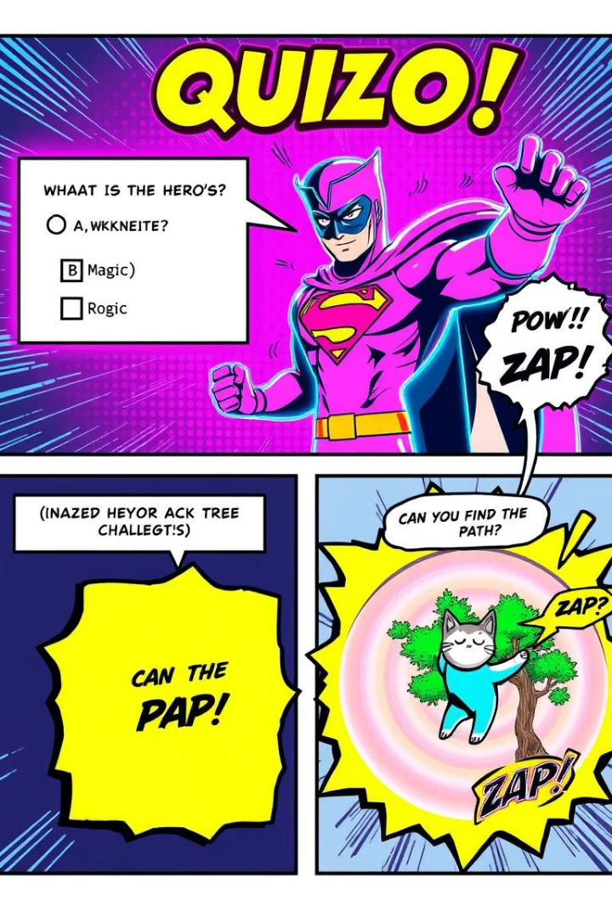
Gamification and Comic Books
Game Elements
Quizzes, puzzles, and challenges engage readers actively.
Rewards
Readers unlock bonus content as they progress.
Examples
Marvel's Infinity Comics feature tap-to-reveal panels.
Tools Used
Unity and Godot enable rich interactive comic features.

Slide 6
Interactive Panels and AR Comics
AR apps Zappar and Artivive animate comic panels
Example:
QR codes trigger unique AR experiences on physical comics
Comic displays alternate endings when scanned via AR app.
AR boosts reader dwell time by 50%

Slide 7
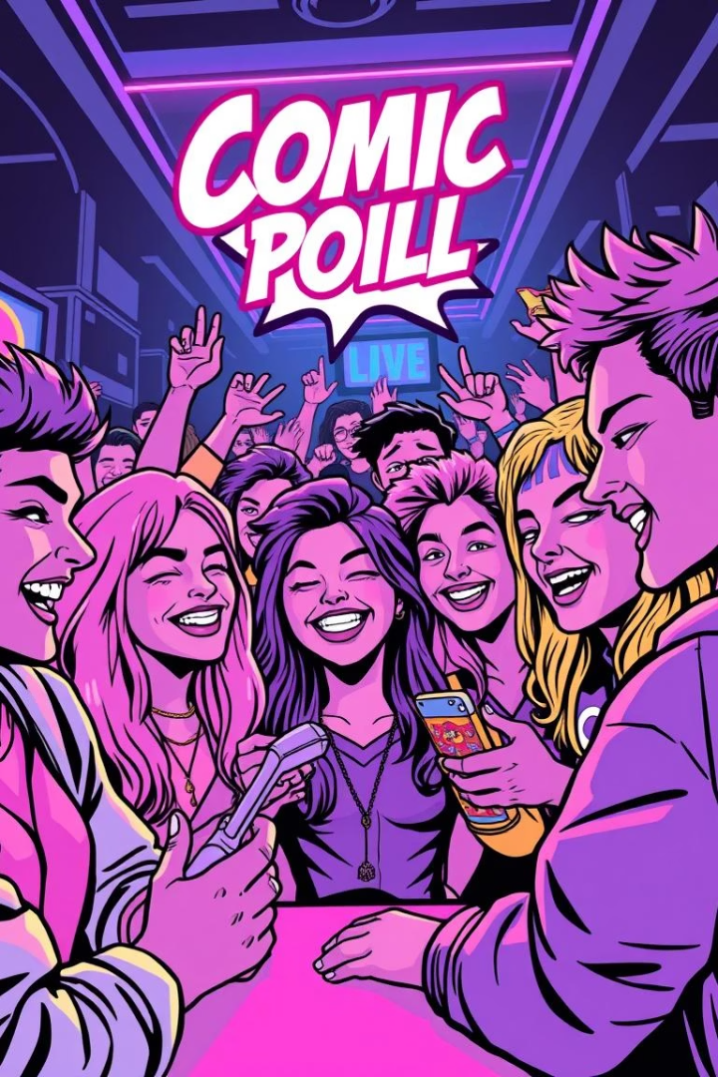
AI for Crowdsourced Storytelling: Fan Participation
Engage Readers
Co-creation
Use polls and surveys to involve fans in story creation.
Collaborate with audience to develop characters and plots.
Live Interaction
Stream platforms like Twitch enable real-time storytelling choices.

Slide 8
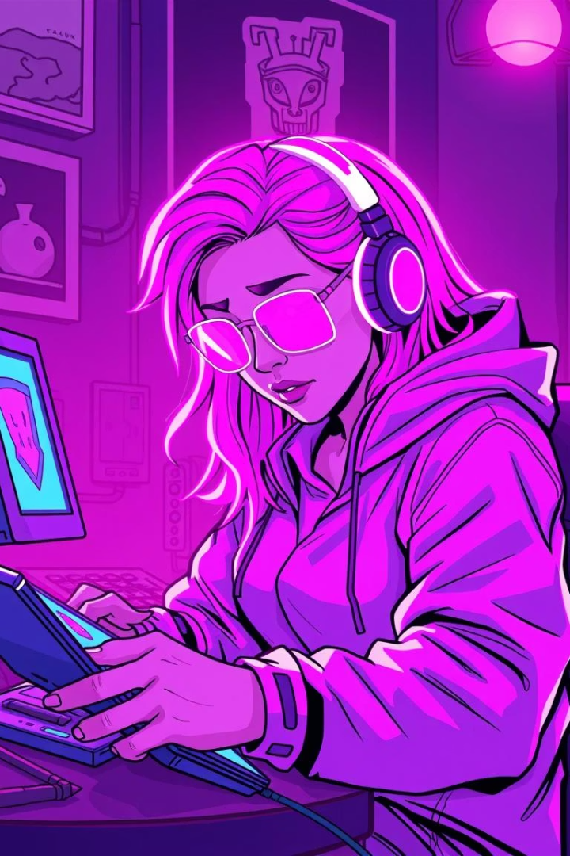
How AI comics Monetization
Generates entire comics with AI
Uses branching narratives and social polls
Built an audience over time
Monetizes via Patreon and other platforms
All Art generated by AI systems is owned by the individual generating them.

Slide 9
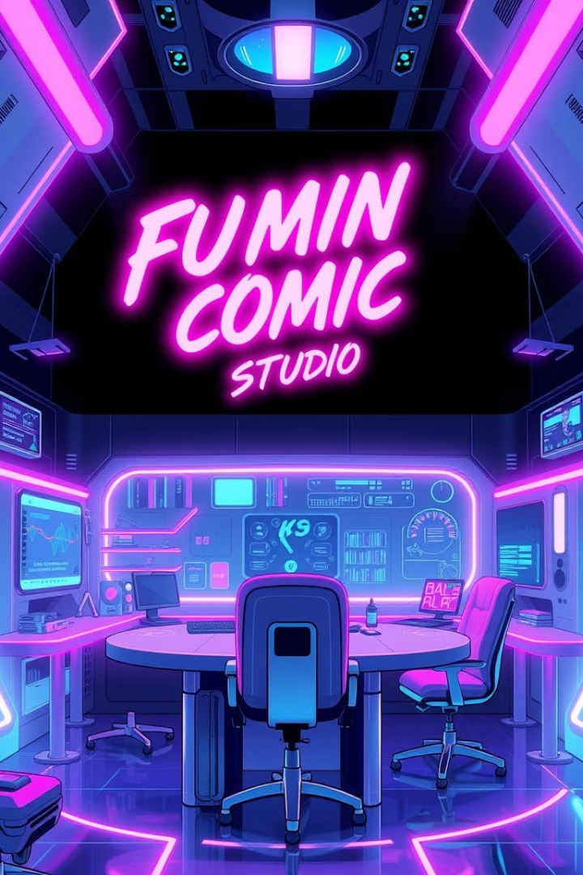



Ethical Considerations & Future Trends
Copyright & Ownership
Artistic Integrity
Personalized Comics
All Art generated by AI systems is owned by the individual generating them.
With AI - now creative prompts hold value
AI-driven adaptive stories and animations.

Slide 10
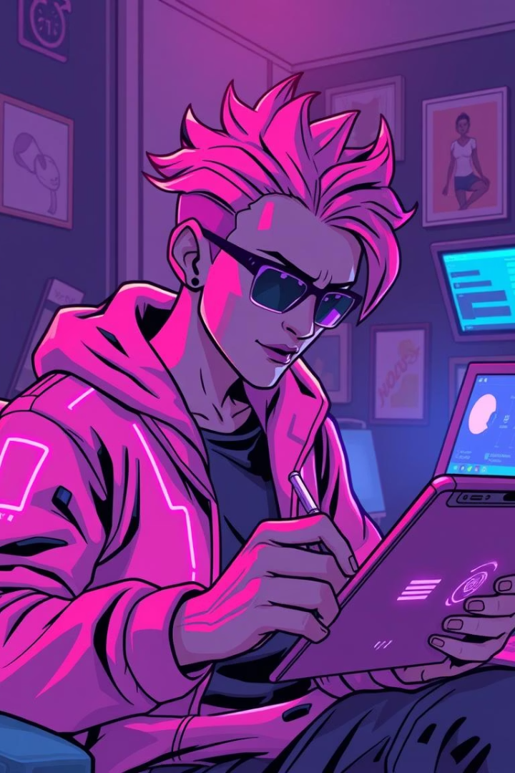
My Idea
Enable more people to access comics
Enabling people to create interactive stories
Bridging the gap between fan art and real comics
This lead to the Idea of creating
Branching Tales

